Slide 1

Gauteng Cooperatives Development Strategy 2021 - 2025
GAUTENG EXCECUTIVE COUNCIL
May 2022

Slide 2

PRESENTATION OUTLINE
Purpose
Background
Problem statement
Roadmap of GPG on cooperatives
Achievements
Challenges
Why the revision of the Strategy?
The Strategy review process
Lessons learned from the benchmarking exercises
Key findings from the GPG procurement database
What is new versus old in the two strategies?
The revised Gauteng Cooperatives Development Strategy 2021-2025 (Key Focus Areas)
Summary of the key findings
Conclusion
Recommendations

Slide 3
PURPOSE
To seek EXCO approval of the revised Gauteng Cooperatives Development Strategy: 2022-2025 pending the finalization of the Implementation Plan.

Slide 4
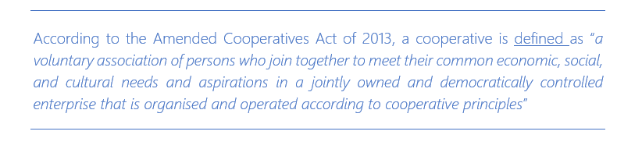
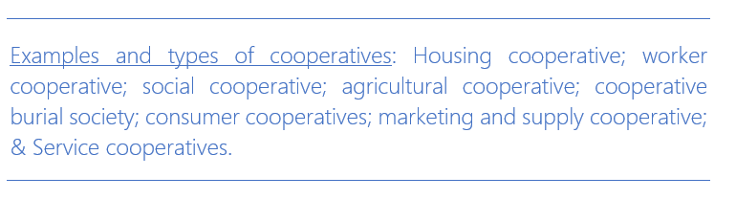
BACKGROUND: UNDERSTANDING THE SCOPE OF COOPERATIVES
Types of cooperatives
Primary
Secondary
Tertiary
Housing co-operative

Slide 5
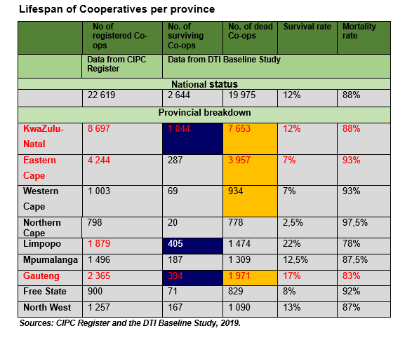
PROBLEM STATEMENT
High mortality rate
Challenges confronting the cooperative sector continued unabated not withstanding the support provided. The impact of Covid-19 has further exacerbated
some weaknesses in the space of cooperatives and exposed the inequality that continues to exist in our country and province.
The CIPC states that at national level, the mortality rate stands at 88% as at 2019 and in Gauteng it is at 83%.
Sector analysis shows a mortality rate that ranges from as low as 68% to as high as 98,2% for Housing and Trading sectors consecutively (Ibid, 40)
Kanyane and Ilorah (2015, 13) state that those that remain in business remain under-developed, resulting in their deteriorating contribution to domestic economic growth
Although there are pockets of success and excellence, these are limited, and they need to be replicated.
Low survival rate
Underdevelopment

Slide 6
ROADMAP FOR GAUTENG PROVINCIAL GOVERNMENT ON COOPERATIVES
GPG continues to put emphasis on the formation, development and support of cooperatives, now with strong focus on Consumer Cooperatives and Cooperative Finance Institutions (CFIs) in the five different corridors of the province.
With the cooperatives Act being first legislated in 2005 and later amended in 2013, a national policy in place, a provincial policy passed in 2007 and later an integrated Cooperatives Development Strategy in 2010, with the current review, the context and support environment for cooperative development in Gauteng has changed dramatically
The 2015 State of the Province Address (SOPA) indicated that provincial government would facilitate the development of cooperatives Finance Institutions (CFIs) across all regions of Gauteng with active involvement of burial societies and stokvels. The aim is to ensure that money generated by people in the township through stokvels and burial societies is used to create wealth and finance business ventures of cooperatives
To bridge the funding Gap, SOPA further pronounced the establishment of the Township Stock Exchange and Cooperatives Bank for SMMEs and Cooperatives
SOPA also pronounced for the establishment of Consumer Cooperatives across the corridors of Gauteng.
The province is now looking forward to expanding the benefits of the Township Economic development Act to cooperatives.
Plans are well in place to ensure that township enterprises and cooperatives reap the benefits of targeted procurement.
GPG has adopted Township Development Act that will see the designation of Township Enterprise Zones where cooperatives will have dedicated spaces for production.

Slide 7

KEY ACHIEVEMENTS
GEP has been providing financial and non-financial support to coops in the form of grants, training and procurement of machinery.
Thirteen CFIs are currently registered in Gauteng as a result of the 2014 SOPA pronouncements. This creates potential for establishment of a Cooperative Bank
7 Gauteng consumer cooperatives are in the pipeline of establishment – 1 is operational and 6 are at the admin stage. The actual stores have not been established due to funding constraints
Umbala Paints is a Coop from Thembisa and is regarded a success case of GPG training and support to coops. The coop was taken for International Exchange Programme in Italy to learn about production of clean paint that is not environmentally harmful. The Coop has a warehouse and is currently looking to expand and build stores across Gauteng and their paint is SABS accredited.
Other successful coops include Greater Uitenhage Sewing Cooperative, Lesedi Primary Manufacturing Coop, Masisizane Women Cooperative and Nhluvuko Agricultural Cooperative
GPG has spent R881,617,516,33 worth of goods and services from coops since 2014 to 2022 through implementation of the 30% procurement policy.

Slide 8
KEY CURRENT CHALLENGES
GEP’s Coops Unit has no resources allocated in terms of budgets and sufficient man-power
Support is biased towards SMMEs than Coops
Training & development of coops is more biased towards business management and there is a roll-out of different short-term training programmes that are less impactful
Since 2014, GPG started implementing the 30% procurement policy from township-based SMMEs and Cooperatives; however, only few Departments procure from cooperatives (limited support from GPG departments).
Lack of a consolidated database of cooperatives supported across the three spheres of government, leading to double dipping with less impact
Lack of proper systems and mechanisms to monitor progress of supported cooperatives
High failure rate regardless of the financial and non-financial support provided with few pockets of excellence
Lack of proper technical education programmes for cooperatives
No procurement target set-aside for cooperatives e.g., there is 30% procurement target and no specific sub-target for coops, it would assist to set aside 5% procurement target for coops

Slide 9
WHY THE REVISION OF THE STRATEGY?
The legislation has changed to include new definition of cooperatives as per Act No. 6 of 2013
Through GGT 2030 the province has adopted the five-township roll-out programmes with more emphasis on jobs and support for 10 high growth sectors
The Township Rebuild programme calls for a 40% value of products to be supplied by SMMEs, so there must be a threshold set aside for cooperatives
The sectors of focus have been added because there is a critical need to keep up with the developments within the economy. There are sunrise sectors on such as technology and digital sectors as well as ensuring that youth graduates are brought into the cooperative programme.
The 30% procurement policy is a gamechanger in that if cooperatives are to be allocated a target and make it mandatory for all GPG Departments and entities to procure from cooperatives, the GGT 2030 could be realized. However, there is no set-aside for cooperatives.
We need to have targeted sectors and a target of cooperatives that needs to be supported with commitments from GPG departments and entities. There is a compiled list of products based on GPT’s database of historical products that are procured by GPG departments.
Innovative funding solutions needs to be explored such as conversion of stokvels and burial societies into a Cooperative Bank in addition to existing funding measures
Incubation programmes for cooperatives to ensure growth, competitiveness and sustainability

Slide 10
THE STRATEGY REVIEW PROCESS
International benchmarking
Desktop analytics
(Procurement from the central database, ….)
Interviews with implementers
Stakeholder Consultations

Slide 11




LESSONS LEARNED FROM BENCHMARKING EXERCISES
SPAIN | KENYA | BANGLADESH | RWANDA
Coordination among government entities to support the development of cooperatives Favourable tax rate for cooperatives Legislate that each Cooperative establish an education and promotion fund | An enabling legislative environment An independent Ministry that drives the promotion of co-operatives The capacity of cooperative movement to mobilise funding Ability of cooperatives to thrive in almost all sectors of the economy Provision of education and training for members through the Co-operatives College Provision of financial support for co-operatives through SACCOs and the national Co-operatives Bank of Kenya | The establishment of a fully capacitated Department of Co-operatives Ability for international institutions like the USID to finance cooperatives The ability for cooperatives to thrive in agriculture and energy sectors Identification of sub-sectors with latent potential within cooperatives and deployment of the necessary support Ability of SACCOS to provide funding without a need for collateral | Establishment of Department of cooperative Setting job targets for each supported cooperative Supporting SACCOS as mechanisms to increase access to finance for cooperatives Implementation of land consolidation project for multiple cooperatives produce one crop

Slide 12
LESSONS LEARNED FROM LOCAL CASES
GREATER UITENHAGE SEWING CO-OPERATIVE | LESEDI MANUFACTURING PRIMARY COOPERATIVE | MASISIZANE WOMEN’S HOUSING COOPERATIVE
Financial assistance (shorter payment turn-around times, within seven days). Woolworths provides GUSCO with the material needed to produce bags as well as transportation needed to transport the goods which reduces GUSCO’s overhead costs. Guaranteed Business: a schedule indicating the amount of stock that GUSCO has to produce is drafted annually when the agreement between the two parties (Woolworths ad GUSCO) is renewed. Mentorship of cooperatives by established businesses. Woolworths manager provided mentorship to GUSCO when challenges arose. | Access to non-financial support such as business, administrative and access dissemination of information is critical. Grant funding for the purchase of equipment and secure premises is essential in developing cooperatives to become viable enterprises. Preferential procurement and mentorship with an established enterprises and government support have the potential and capacity to building sustainability and profitability of cooperatives. | Small enterprises can deliver on large projects provided they get assistance from government and private sector. In this case, the Gauteng Department Housing/Human Settlements applied preferential procurement in its dealing with the cooperative. Compliance issues can be overcome if the involved stakeholders are able to assist the social enterprise in complying fully. This can be in terms of licensing, grading (construction), training etc.

Slide 13
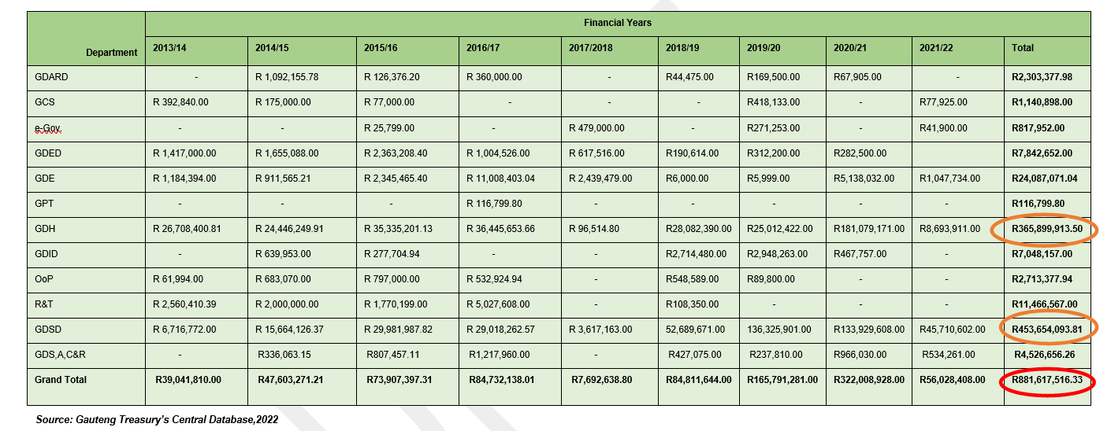
AREA 1 : KEY FINDINGS FROM THE ANALYSIS OF GPG PROCUREMENT DATABASE
GPG procurement spent on cooperatives from 2014 - 2022

Slide 14
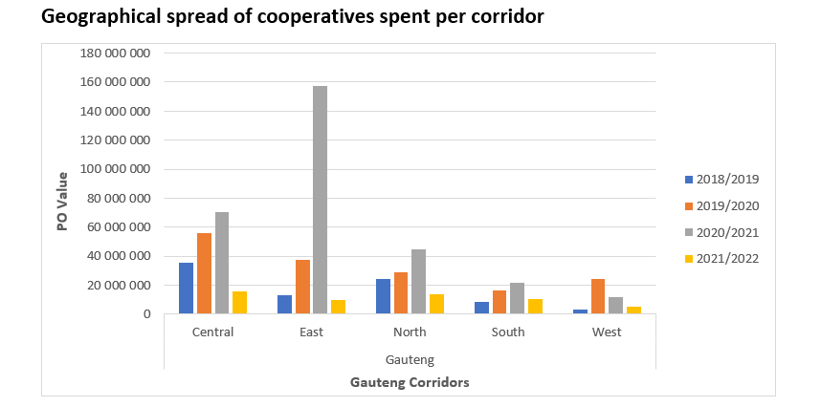
AREA 2 : KEY FINDINGS FROM THE ANALYSIS OF GPG PROCUREMENT DATABASE
GPG procurement spending is biased in favor of the already developed regions of the province; i.e. the three metros of the Province.
Two government departments i.e. Gauteng Department of Health and Department of Social Development play a meaningful role in terms of procuring from cooperatives
The combined procurement expenditure on cooperatives by GPG departments with the exception from the Gauteng Departments of Health and Social Development, stands at a mere 17%.
The procurement expenditure also shows a positive move towards addressing gender imbalances because majority of cooperatives supported (58%) is majority-owned by women.
There is a drawback in terms of ownership by people with disabilities from cooperatives supported where the percentage supported stands at just 1%.

Slide 15
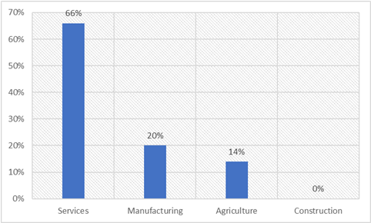
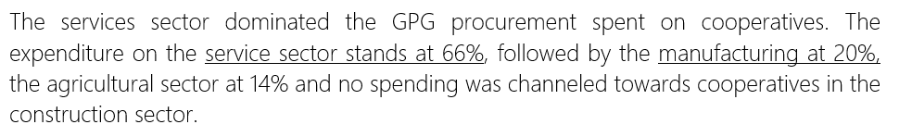
AREA 3 : KEY FINDINGS FROM THE ANALYSIS OF GPG PROCUREMENT DATABASE
Procurement spent on cooperatives by sector
Source: Gauteng Provincial Treasury database, 2022
TYPE OF GOODS AND SERVICES PROCURED FROM COOPERATIVES
SECTOR | TYPE OF GOODS / SERVICES
SERVICES | Cleaning services, laundry services, stationary supplies, catering and groceries supplies, educational training programs, supply and removal of medical waste, repair & service of medical instruments, security services private, nutrition programme primary school, supply of promotional items, service hiring of venue rental (hiring) of recording sound, conference facilities service, accommodation service, maintenance service telecom equipment, installation and configuration network, garden services
MANUFACTURING | Apparel, Blankets, lotions, Beddings, Thermostat for geyser, chairs, siren and microphone, umbrella portable canvas concrete base, first-aid kit, stationery, tablecloths, draw sheets and curtains
AGRICULTURE | Farming equipment

Slide 16

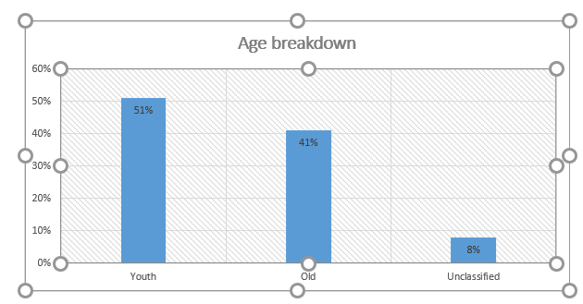
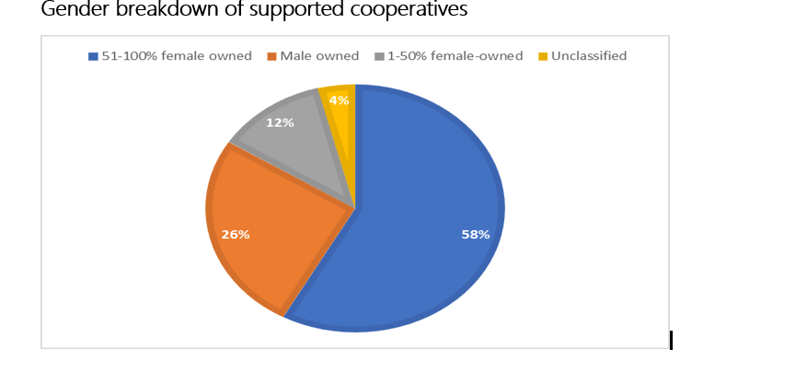
DISTRIBUTION OF GPG PROCUREMENT TO COOPS BY AGE AND GENDER

Slide 17
AREA 1. WHAT IS NEW VERSUS OLD IN THE TWO STRATEGIES
OLD STRATEGY | NEW STRATEGY
 | Increase the supply of financial support services to coops Incentives and existing funding instruments Establishment of CFIs and Cooperative Bank Township Economy Partnership Fund
 | Create demand for cooperatives products and services (New programmes) Set aside 5% procurement budget for coops from BBBEE Fund Make provision for cooperatives in the 40% procurement target from TEZs Make it mandatory for all GPG department and entities to procure from cooperatives Category 1: Access to markets in the public sector Category 2: Access to markets in the private sector Category 3: Exports promotion Improve sustainability cooperatives in manufacturing (New programmes) Incubation programmes for cooperatives with targeted sectors linked to GPG Cooperatives in the TEZs & Taxi Economy Programmes Undertake annual funding fair Investment readiness programme
Increase the supply of non-financial support services to cooperatives
Improve the sustainability of cooperatives
Increase the supply of financial support services to cooperatives
Create a demand for cooperatives products and services

Slide 18
AREA 2. WHAT IS NEW VERSUS OLD IN THE TWO STRATEGIES
OLD STRATEGY | NEW STRATEGY
 | Education & training (New Pillar) Local & International Exchange Programme Partnership with institutions of Higher Learning to establish Cooperative Center / College Bi-annual funding fair Investment readiness programme
 | Promotion of Youth Graduate Cooperatives (New Pillar) Smart industries (digitization & innovation) Advance manufacturing Graduate Cooperatives in TEZs’s digital and techno hubs Research & Development (R&D) Cross-Cutting Programme M&E Local, Provincial & National Cooperatives Forums
Increase the supply of non-financial support services to cooperatives
Improve the sustainability of cooperatives
Increase the supply of financial support services to cooperatives
Create a demand for cooperatives products and services

Slide 19
THE GAUTENG COOPS DEVELOPMENT STRATEGY 2021 – 2025: AREAS OF FOCUS
Increase the supply of financial Support services to cooperatives
Incentives and existing funding instruments
Creating demand for cooperatives products & services
Creating Demand for Cooperatives:
Improve sustainability of cooperatives
Establishment of CFIs and Cooperative Bank
Category 1: Access to markets in the public sector
Category 2: Access to markets in the private sector
Category 3: Exports promotion
Township Economy Partnership Fund
Set aside 5% of procurement for Coops from BBBEE Fund
Cooperatives in the Township Zones
Cooperatives in the Taxi Economy nodes
Convene annual funding fair
Convene Investment readiness programmes
Support cooperatives in:
Increase the supply of non-financial services to cooperatives
Promotion of the Youth Graduate Cooperatives
Education & Training
Networking & Mentorship
Technology and innovation support
Quality & standards
Production infrastructure through Township Enterprise Zones and Industrial Parks
Machinery & equipment
Local & International Exchange Programme
Partnership with institutions of Higher Learning to establish Cooperative Center / College
Smart industries (digitization & innovation)
Advance manufacturing
Research & Development (R&D)

Slide 20

THE GAUTENG COOPS DEVELOPMENT STRATEGY 2021 – 2025: AREAS OF FOCUS
Cross-cutting
Policy Advocacy
Convene Bi-annual provincial Forums
Local, provincial and national coops Forums
Data collection
Monitoring & Evaluation
Target to support 2000 sustainable cooperatives business entities; and create 10 000 jobs; by 2025

Slide 21
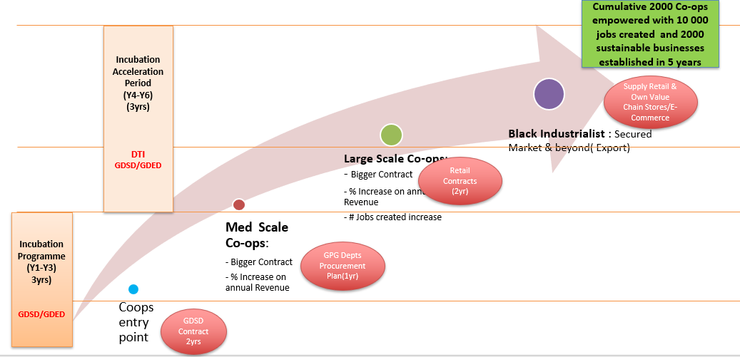
TRANSFORMATION AND SUSTAINABILITY MODEL LEADING TO CREATION OF 10 000 JOBS

Slide 22
THE GAUTENG COOPS DEVELOPMENT STRATEGY 2021 – 2025: DESIGNATED SECTORS
Designated Sector | Targeted sub-sectors | Targeted institutions
Manufacturing | Production of sanatory pads, detergents, paint, smart industries and advanced manufacturing | Procurement by all GPPG departments
Agriculture and agro-processing | Farming, packaging & manufacturing of canned foods and sources | Procurement by all departments involved in catering such as Departments of Correctional Services, DoE,
Services Sectors | Cleaning of roads & parks, gardening, catering services of government buildings and security services, car wash of G-Fleet, Laundry services | Department of transport, Department of Health, municipalities. Provision of gardening services to schools, government departments and municipalities
Waste & Recycling | Collection of waste and recycling | All corridors, GDARD
Finance | Cooperatives Banks and CFIs | All corridors
Retail | Consumer Cooperatives | All corridors
Construction & maintenance | Building of low-cost housing, cleaning of roads, parks and public spaces, installation and fixing of district public schools and hospitals | Department of Human Settlements, Department of Roads and Transport, Department of Health and Education
Clothing and textile | School uniform | Qualifying Gauteng public schools

Slide 23
Key takeaways
Case studies | Analysis from central database | Recommendations from implementers
Availability of Cooperatives Departments (capacitate units responsible for cooperatives across the three spheres of government) | Only two departments (DoH and DoE) have contributed more than 30% worth of procurement from GPG. (set aside 5% procurement target and make it mandatory for GPG departments and entities to procure from cooperatives) | Lack of coordination, and policy coherence (create an agenda on cooperatives in IGR and ensure that the existing forums are well coordinated and enhanced)
Tax benefits for cooperatives (to motivate and advocate at national government level) | Only 3 cooperatives sort markets from the private sector (the new strategy recommends 3 categories of access to markets i.e. government, private sector and exports) | Poor procurement from cooperatives is as a result of goods and services that are of sub-standard (support cooperatives in partnership with SABS and other partners)
The Use of SACCOS to fund Cooperatives (promote the rolling out of CFIs and Coops Bank for Gauteng) | Further recommendations Promote youth cooperatives from institution of higher learning to help the province realise a dream of becoming a Silicon Valley of Africa Enhance current training and mentorship programmes for cooperatives in the manufacturing sector. There is a need for improved data collection across the three spheres of government
Tailor-made education programme for cooperatives through Cooperatives College (partner with institutions of higher learning and TIVET colleges to ensure tailor-made education curriculum for cooperatives)
Cooperatives have a footprint across all sectors including finance, electricity, housing etc. ( the new strategy has added new sectors of focus for support)
Target cooperatives to be supported trough procurement and incubation (2000 cooperatives are expected to be supported with membership of 5 natural parsons each)

Slide 24
IMPLEMENTATION APPROACH & M&E
All GPD Departments to provide a target of cooperatives to support linked to designated products
From the BBBEE budget allocation, all departments are expected to set aside 5% for cooperatives and set targets leading to the recommended target of 2000 sustainable cooperative business entities that will create 10 000 sustainable jobs
GDED will support the rolling out of consumer cooperatives, CFIs and Coops Bank
GEP to provide financial and non-financial support
Coops Unit of GEP be allocated budget to support cooperatives
Coordinated database for monitoring and evaluation by GDED and GEP
GDED to provide support to all departments and monitor the implementation of the strategy

Slide 25
CONCLUSION
There is a need to ensure growth, development and sustainability of cooperatives through innovative funding solutions, technical training and skills as well as promotion of training on principles of cooperatives as these are biggest attributes to high failure/death rate.
Enhancement of government procurement from cooperatives will go a long way in promoting inclusive ownership of assets in our local communities. TEDA makes provision for targeted procurement from Township Economic Zones hence cooperatives ought to benefit from this.
Rigorous support and funding of consumer cooperatives can bring a paradigm shift in the retail sector, particularly in townships
The incubation programme can assist the province to realise sustainable cooperatives in manufacturing as well as realise the township revitilisation agenda of creating productive assets and jobs
Industrial cooperatives can be key in expanding the manufacturing base of the province
Graduate cooperatives are envisaged to play a key role to venture into sectors of high levels of technology and digitization

Slide 26
RECOMMENDATION
It is recommended that EXCO approves :
The revised Gauteng Cooperatives Development Strategy: 2022-2025 and pending finalization of the implementation plan.
The 5% procurement budget set aside (from the targeted 40% BBBEE budget) by all GPG departments for cooperatives. The list of products for procurement is attached as part of the addendum for the strategy.
That GPG discontinues individual departmental training programmes and implements a tailormade cooperative enterprise curriculum in partnership with institutions of higher learning, TVET colleges and private sector to provide relevant and impactful training to cooperatives.
That all departments commit to the provincial target of supporting 2000 sustainable cooperatives in the province leading to 2025.

Slide 27


